Slide 1
Containerization with Docker for ML Models
Turn Machine Learning Models into Production-Ready Containers.

Slide 2
Content
01
02
The Deployment Problem
Docker Fundamentals
Why ML models fail outside your local machine
Images, containers, and how Docker works
03
04
Our ML Project
Hands-On & Outcomes
Bank loan model, project structure, and Dockerfile
Commands, results, real-world applications, and key takeaways

Slide 3
From ML Model to Real-World Use
"An ML model is valuable only when it runs reliably in production."
Building a Model
The Real Challenge
The Goal
Training and evaluating your ML model is only half the job.
Deployment — making the model run outside your own system.
The model must run reliably in any environment, not just yours.

Slide 4

What is Docker?
Docker is a tool for containerization — it packages everything needed to run an application into a single portable unit.
Definition: "Docker packages an application and its dependencies into a container for consistent execution across environments."
Code
Libraries
Your application source files
All required packages
Runtime
System Tools
Python or other language runtime
OS-level dependencies

Slide 5

What is a Docker Image?
Definition: A Docker image is an immutable, read-only blueprint that packages your application code along with all its dependencies.
Cannot be modified once created
Acts as a template
One image → Multiple containers
Think of it like a recipe — it describes exactly what to prepare.
Images are fixed snapshots — they never change after being built.
A single image can be used to spin up many running instances.

Slide 6

What is a Docker Container?
Definition: A Docker Container is an isolated environment where your application actually executes.
What it isolates
How it works
Processes
File systems
Network
Uses the host OS kernel
Isolation via Namespaces
Resource control via cgroups
🍽️ Analogy: If the Image is the recipe, the Container is the cooked dish — this is where your ML model
actually runs.

Slide 7
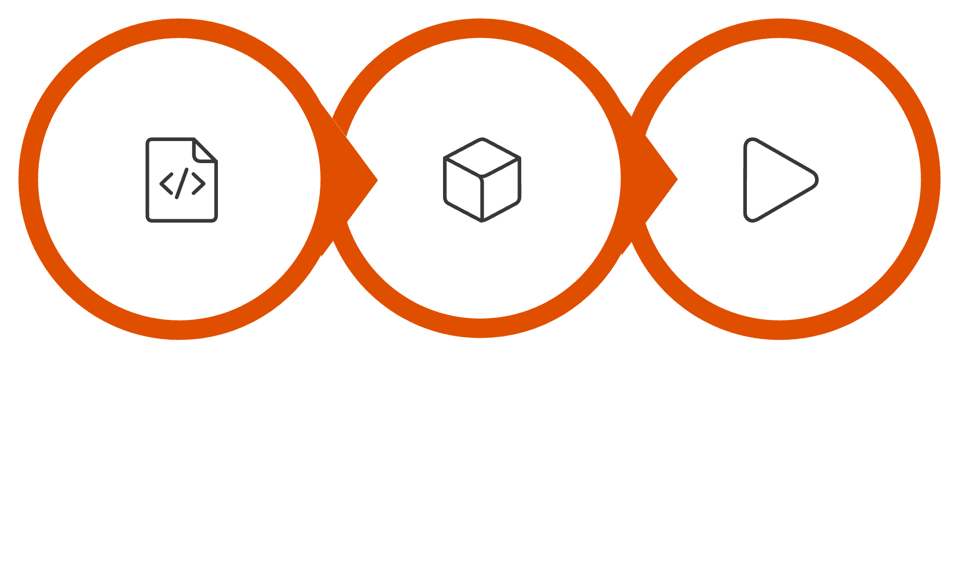
How Docker Works
Write Dockerfile
docker build
docker run
You write a Dockerfile — a configuration file. Running docker, build compiles it into a static Docker Image. Running docker run turns that image into one or many isolated, running containers.
"One image → Multiple containers → Scalable execution"

Slide 8

What We Built — The ML Pipeline
Bank Loan Data
Train Model
Save model.pkl
Run Prediction
Dataset
Model
Serialization
Bank Loan Dataset used for training
Logistic Regression classifier
Model saved using pickle as model.pkl

Slide 9

Files in Our Project
"All components needed to run ML are now packaged together."
train.py
app.py
model.pkl
Model training script — loads data, trains the Logistic Regression model
Prediction script — loads the saved model and runs inference
Saved trained model, serialized using pickle
requirements.txt
Dockerfile
Lists all Python dependencies needed to run the project
Build instructions — tells Docker how to package everything
NOTE : In deployment, train.py isn’t needed since the model is already saved (model.pkl), and it’s included here only to explain the full ML lifecycle.

Slide 10
Dockerfile Content
FROM python:3.10
WORKDIR /app
COPY . .
RUN pip install -r requirements.txt
CMD ["python", "app.py"]
01
02
03
FROM python:3.10
WORKDIR /app
COPY . .
Sets the base environment — Python is pre-installed
Sets the working directory inside the container
Copies all project files into the container
04
05
RUN pip install
CMD ["python", "app.py"]
Installs all required Python dependencies
Runs the prediction script when the container starts
Note: A Dockerfile is a plain text file without any file extension that contains instructions to build a Docker image.

Slide 11
Creating Docker Image And Running Container
Two simple commands are all it takes to build and run the containerized ML model:
docker build -t loan-model .
docker run loan-model
No Python Install
No Dependency Setup
Consistent Output
Python is already inside the container — nothing to set up on your machine.
All libraries are pre-installed during the build step.
Same result across every system — no surprises.
"You didn't install Python, didn't install libraries… Still the model ran perfectly."

Slide 12
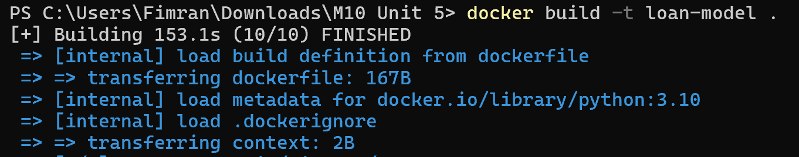
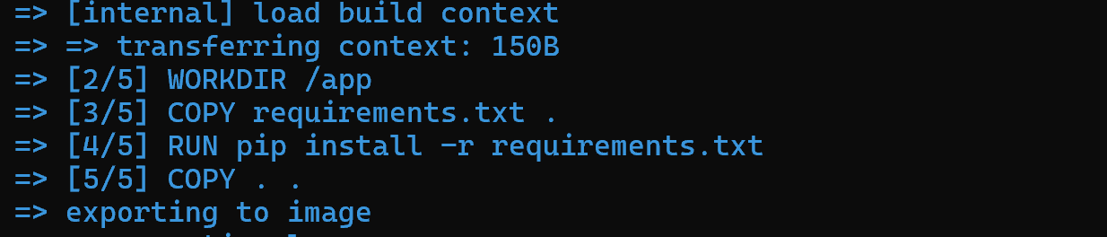
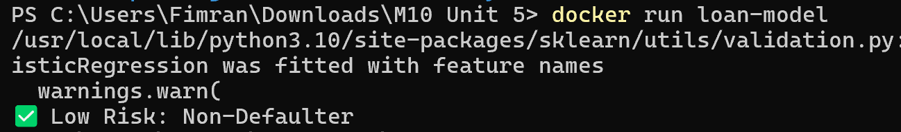
Execution Output
Running the Docker Container
Steps:
1. Build the Docker Image
docker build -t loan-model .
2. Run the Container
docker run loan-model
What to Observe:
• Image builds successfully
• Container starts without errors
• Model executes and gives output

Slide 13
How to Share Your Docker Project
Instead of sharing code + setup, we share the Docker Image.
📦 Export Image (Sender Side)
📥 Import Image (Receiver Side)
▶️ Run the Application
docker save -o loan-model.tar loan-model
Creates a single file (loan-model.tar) containing the complete application.
docker run loan-model
docker load -i loan-model.tar
No need to install Python, libraries, or dependencies — just load and run.
"Ship the image, not the environment."

Slide 14
What Did We Achieve?
❌ Before Docker
✅ After Docker
Environment-dependent
Hard to reproduce
"Works on my machine" problem
Fully portable ML application
Reproducible results
Easy deployment anywhere
"If it runs in Docker, it runs anywhere."

Slide 15




Where is Docker Used?
ML APIs
Cloud Platforms
Deploy ML models as REST APIs using Flask or FastAPI inside containers
Run containers on AWS, GCP, and Azure for scalable cloud deployments
Microservices
CI/CD Pipelines
Break large applications into small, independently deployable services
Automate testing and deployment of ML models in production workflows
"Docker bridges the gap between Data Science and Production."

Slide 16
Key Concepts at a Glance
A quick reference summary of everything covered in this session.
Term
Definition
Analogy
Docker
Tool for containerizing applications and dependencies
A universal shipping box
Image
Immutable, read-only blueprint of the application
A recipe
Container
Isolated running environment created from an image
The cooked dish
Dockerfile
Configuration file with build instructions
Step-by-step cooking instructions
docker build
Compiles the Dockerfile into a Docker
Image
Preparing the recipe
docker run
Launches a container from an image
Serving the dish

Slide 17
Key Takeaways
1
Deployment is as important as model building
A model that can't run in production has no real-world value.
2
Docker = Portability + Reproducibility
Package code, libraries, and runtime together — run anywhere, every time.
3
Image is the blueprint; Container is the execution
One image can create many containers. Think: Recipe → Cooked Dish.
4
Dockerfile drives everything
FROM, WORKDIR, COPY, RUN, CMD — five instructions to containerize any ML model.
5
Docker is industry-standard
Used in cloud platforms, CI/CD pipelines, microservices, and ML APIs worldwide.

